Slide 1
Reuse and Recycle, Save the World
Made from the recycled concepts of John Luo, Richard Vook, Albert Zhang, and Lihan Zhang

Slide 2
What is our theme?
The general topic we were given was “sustainability”. Sustainability itself is a very broad topic, so we narrowed it down. We choose recycling as our point of focus.
Did you know?
Recycling has many benefits, much more than the average person thinks.
If creates jobs; there are ten times more jobs in recycling processing and twenty five more times in recycling manufacturing than there are in landfill jobs.
Recycling and manufacturing reduces greenhouse gas emission by almost 194 times than regular landfills.

Slide 3







What is this?
It’s a game, tailored to the younger generation of children to teach them about recycling through a simple yet addictive game.
It combines simple concepts to create a game that is juvenile but belies the true nature of our goal: to raise awareness for sustainability.

Slide 4
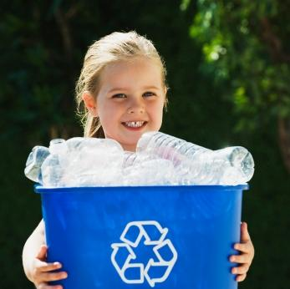
Why did we do it?
Sustainability can only be achieved if we are able to engage future generations. If we do not engage the next generation, all our efforts will be at a loss. It will take courageous children to carry and eventually pass on the eco friendly torch of sustainability to the next generation.
Younger generations are easily impressionable, so creating a small, easy game for a big cause would be very effective at raising awareness for younger generations.

Slide 5
Credits
John Luo - Lead designer/master of graphics
Richard Vook - Back End Design
Albert R. Zhang - Software compatibility engineer
Lihan Zhang - Front/Back end design

Slide 6
Sources:
http://cf.ltkcdn.net/greenliving/images/std/131400-347x346-child_recycling_plastic.JPG
http://www.greenwaste.com/recycling-stats
http://www.ecocycle.org/files/pdfs/why_recycle_%20brochure.pdf
https://lh4.ggpht.com/cN2XyGoWzSGVhMkzQi-ufhpFkOOQF8nKHPlWUxyAaKDggpCpLabr-j3oEQ2PlWISQD1Zlw=s66
https://www.google.com/search?sa=G&tbm=isch&tbs=simg:CAQSZRpjCxCo1NgEGgIIAAwLELCMpwgaPAo6CAISFMAIsgzZCb8Imwi5CIQIvgjcCa4MGiCz7-SpMgIzXjlTgQktHr6Cti-DWePginpewVXDMzZHWwwLEI6u_1ggaCgoICAESBIK9qIcM&ei=ZrcVVPiENPeUsQTRm4DADg&ved=0CBsQwg4oAA'
https://lh3.ggpht.com/k8bOETPSkEJ3tXXaGbsvCojCs7lrd9hXz0H8J77AyuuC9E1LtEx_-tve2XNpZCd1UTRAOQ=s65
https://lh3.ggpht.com/Umi-cGPXgIZjzZ5CLKwhqLDhN6b-Z65lz0IWj1exNwEUAwzMMBahzBAHh1VGeHCrapmN=s50
https://lh3.ggpht.com/iEfPk7peyNeqxpnEeNbhcEZ6s36uimLJ2c-8Dl46y9VsW2fSVMCZnJ3BRAsqfGp-jkq48Q=s63
https://lh6.ggpht.com/iOv5FDGGY1LdQoxKC6gqgJj-XnYx0QsdlnYFEiLgyZsngTuWKbD99cyod0Jc45womsw16g=s128
https://lh4.ggpht.com/f5bKm4EuGZTw_Y9h4D7Env8yD15cCPs20oLH5h1pj0IOsXuXwQzGoWJizEIqZUDc-0Mqww=s50

Slide 7
Thank you for your time

